Slide 1
My great-grandparents
Beto and Rosalinda

Slide 2
MY GREAT-GRANDPARENTS
When they were young,my great-grandparents lived in a small house in a village in the countryside.My great-grandfather worked on a farm and my great-grandmother was a housewife.
They had an old car. They didn't go to supermarket.They went to street markets.They didn't had a washing machine.My great-grandmother washed clothes by hand.They didn't had a computer or internet but they enjoyed with knitting needles and read books.
Every week my great-grandmother cleaned the house and knitting needles and my great-grandfather sold the harvest and played cards.
my grandfather says that my great-grandparents were happy.
By Naroa

Slide 3
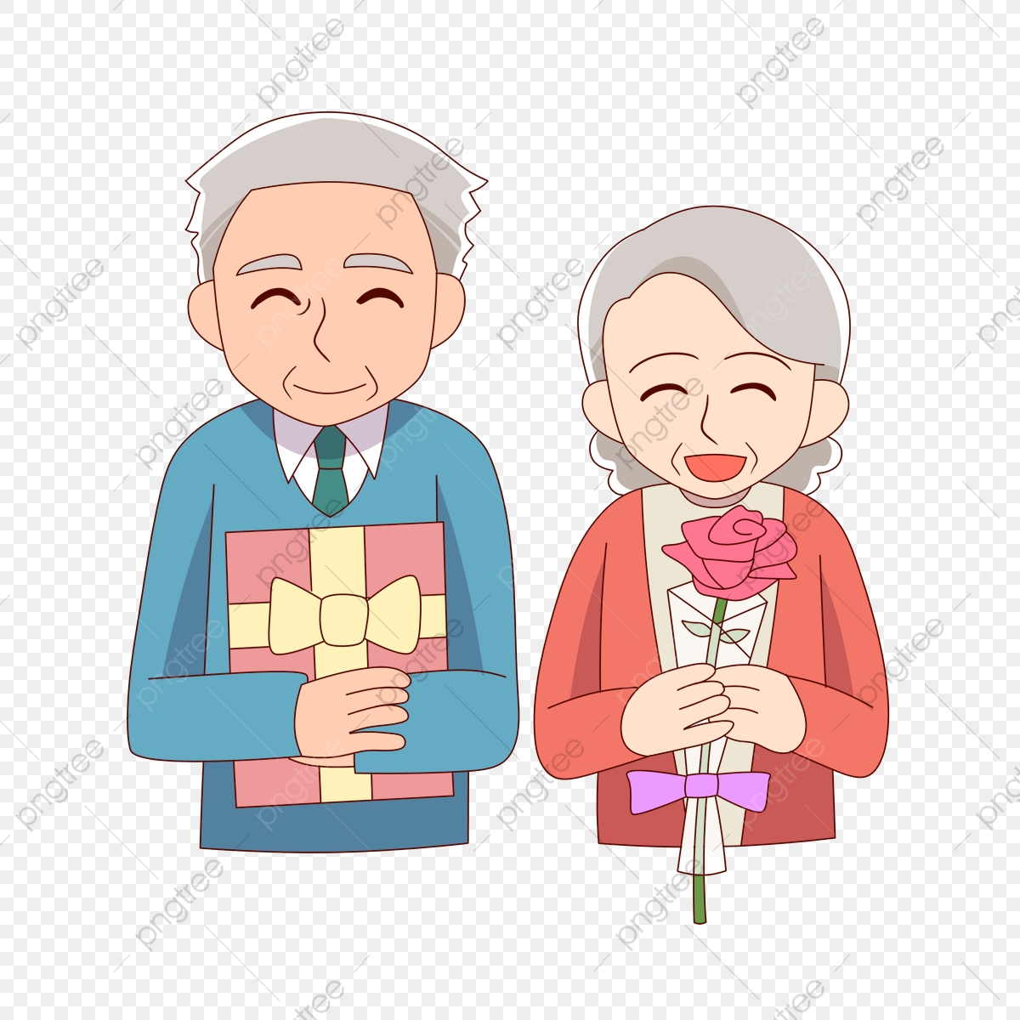
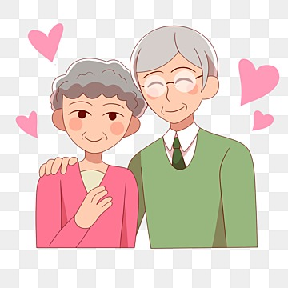

Slide 4
BAY AND LOVE YOURS GREAT-GRANDPARENTs

